Slide 1
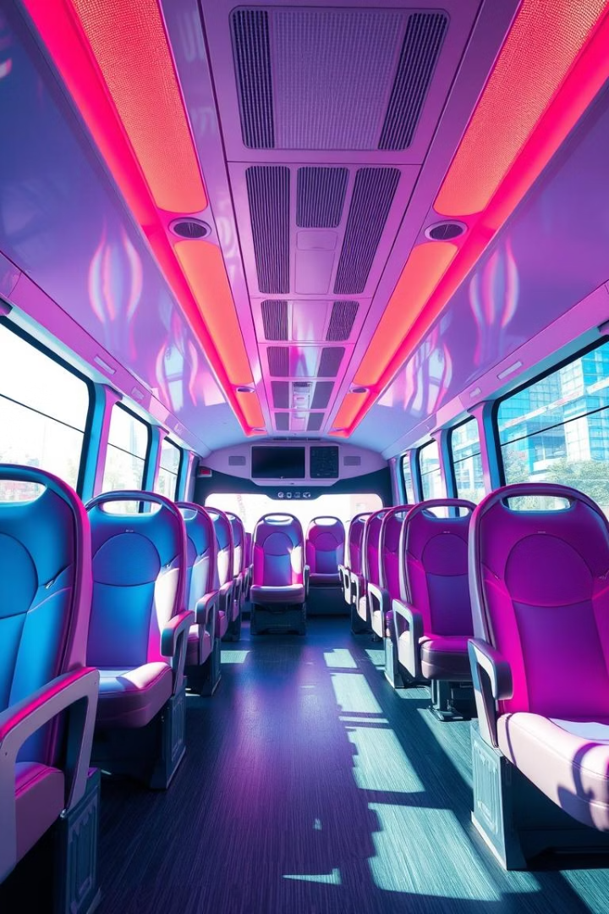
Bus Seat Booking System in C
Simple console-based system for booking, canceling, viewing, and saving seats.
Learn file handling, 2D arrays, and basic algorithms in C.
Presented by ,
Rakesh, Paramesh Varma, Raghuram And Satya Pramod

Slide 2
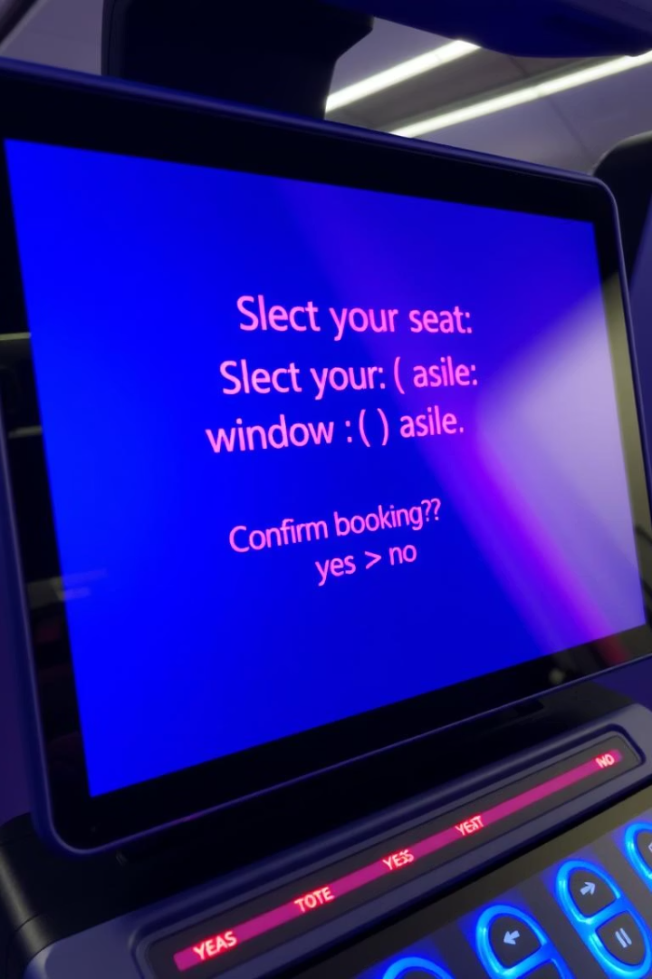
Objective
Small-scale system
Data management
Easy-to-use seat booking application
Use arrays and file operations
Enable Booking , Cancellation And Saving bookings to A File

Slide 3
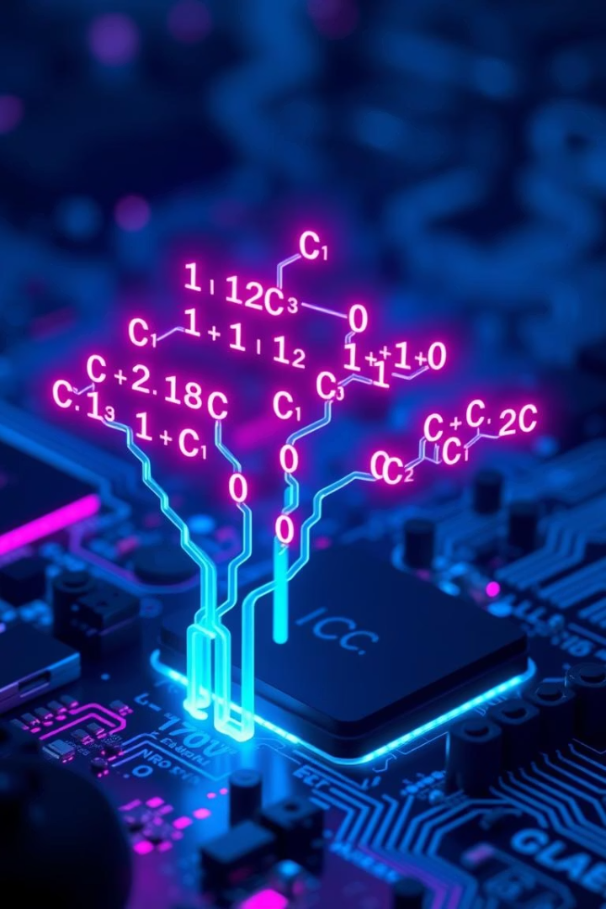
Why C and DSA?
C Language
Foundation of programming, direct memory control
2D Arrays
Represent seating layout efficiently
Algorithms
Book, cancel, save seats efficiently
Problem-solving
Learn optimized coding techniques

Slide 4





Algorithm Used
Initialize seats
Set all seats as Available (A)
Display status
Show current seat map
Menu options
Book Seat: A to B
Cancel Seat: B to A
Save to file
Exit
Validate input
Check row and column range
Save updates
Update seat map accordingly

Slide 5

Lessons Learnt
User input handling
Menu-driven program design
File handling
Save data permanently
Error checking
Handle invalid input and bookings
2D arrays
Manage structured seat data

Slide 6
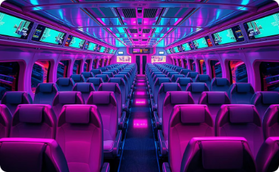
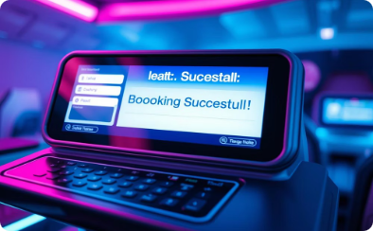
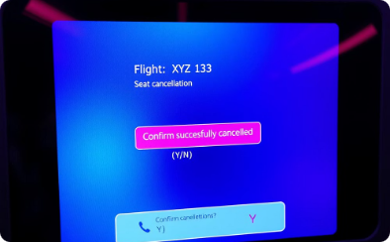
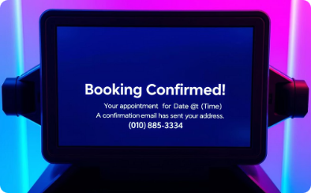
Visuals of System
Seat Map
Booking
Cancellation
Save Confirmation
Initial seat availability display
Seat booking process
Cancel booked seat
Bookings saved to file

Slide 7
Sample Output
Seat Map: 5 rows, 4 columns
Menu options:
A = Available, B = Booked
1. Book Seat
Example:
2. Cancel Seat
3. Save to File
1 2 3 4
4. Exit
Row 1: [B] [A] [A] [A]
Row 2: [A] [A] [A] [A]
Row 3: [A] [A] [A] [A]
Row 4: [A] [A] [A] [A]
Row 5: [A] [A] [A] [A]

Slide 8
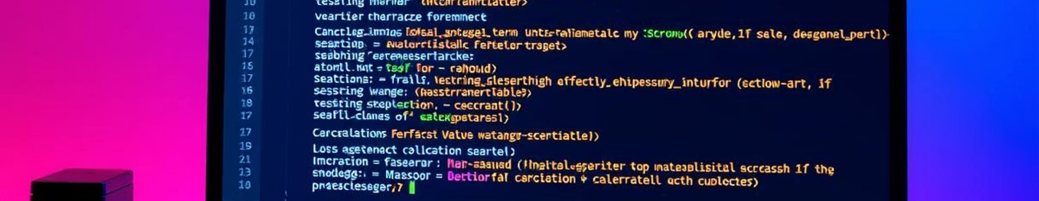
Source Code Highlights
InitializeSeats()
DisplaySeats()
Set all seats to 'A'
Print seat map with rows and columns
BookSeat() & CancelSeat()
SaveBookingsToFile()
Change seat status with validation
Write seat map to file

Slide 9
User Interaction Flow
Display seat map
Choose menu option
Input seat position
Confirm booking or cancellation
Save or exit

Slide 10

Conclusion:
Understand C basics
Apply problem-solving
Arrays, file handling, algorithms
Menu-driven program design

